Slide 1
Soccer referee abuse and assault are each very serious crimes against the sport and MUST be reported to the proper authorities.
The Washington State Referee Committee and the Leadership of the Affiliated Playing Associations (US Adult Soccer, US Youth Soccer and US Club Soccer) are committed to promptly acting on every report of such conduct.

Slide 2
Such “Abuse/Assault” against referees may occur before, during, and after a match — including travel to and from a match.
Additionally, such abuse/assault may also occur at later times when directly related to duties of a game official as a referee.

Slide 3
It is critical that referees make a reasonable attempt to correctly identify those involved in abuse and assault
A report must be promptly submitted to the proper authorities of any such incidents.
For assistance in completing a report, send an email to
reports@wareferees.org.

Slide 4
“Referee” includes the following:
(a) all currently registered USSF referees, assistant referees, fourth officials or others duly appointed to assist in officiating in a match.
(b) any non-licensed, non-registered person serving in an emergency capacity as a referee.
(c) any club assistant referee.

Slide 5
What is referee abuse?
Referee abuse is a verbal statement or physical act
not resulting in bodily contact…
Which implies or threatens physical harm to a referee or the referee’s property or equipment.

Slide 6
What is referee abuse?
What is referee abuse?
Abuse includes, but is not limited to the following acts committed upon a referee:
Using foul or abusive language toward a referee that implies or threatens physical harm; such as remarks like:
“I’ll get you after the game,” or “You won’t get out of here in one piece.”

Slide 7
What is referee abuse?
What is referee abuse?
Abuse includes, but is not limited to the following acts committed upon a referee:
Spewing any beverage on a referee’s personal property;
Spitting at (but not on) the referee.

Slide 8
What is referee abuse?
What is referee abuse?
  Step 1 - Recognize and Identify the Abuse
  Step 2 - This is always an immediate “send-off”
  Step 3 - Send Referee Report(s) to the proper authorities.

Slide 9
What is referee assault?
What is referee assault?
Referee assault is an intentional act of physical violence at or upon a referee.
“intentional act”

Slide 10
What is referee assault?
What is referee assault?
Intentional Act means - intended to bring about a result which will invade the interest of another in any way that is socially unacceptable.
Unintended consequences of the act are irrelevant.

Slide 11
What is referee assault?
Referee assault is an intentional act of physical violence at or upon a referee, including:
Striking, kicking, choking, head butting, grabbing, or bodily running into a referee, or,
Spitting on a referee with apparent intent to do so

Slide 12
What is referee assault?
Referee assault is an intentional act of physical violence at or upon a referee, including.
Kicking or throwing an object at an official that could inflict injury
Damaging the referee’s uniform or personal property

Slide 13
What is referee assault?
  Step 1 - Recognize and Identify Assault
  Step 2 - The game is abandoned (must not continue)
  Step 3 - Police, 911, are called
  Step 4 - Referee Report to the proper authorities

Slide 14
Official notification of the incident
Contact, via phone, text or email:
All of the below: - as soon as possible, at least by the next business day to make them aware of the incident.
(a) The President of the State Association that has jurisdiction over the game (Youth or Adult), AND
(b) The State Referee Administrator, AND
(c) The Washington State Referee Committee Office AND
(d) Your Assignor

Slide 15
How to complete a referee report
Complete a US Soccer [a] Referee Report & [b] Supplemental Report to record basic game data (see next page for links)
Provide a clear, concise and factual account of what happened
Include all relevant information to identify the person(s) involved
Do NOT give opinions or recommendations
Confirm the details in the report with all other officials

Slide 16
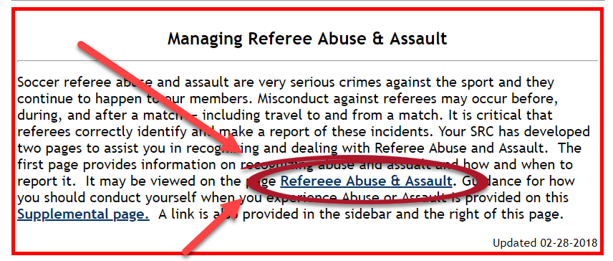
How to complete a referee report
Go to www.WAReferees.org – bottom of the Home page

Slide 17
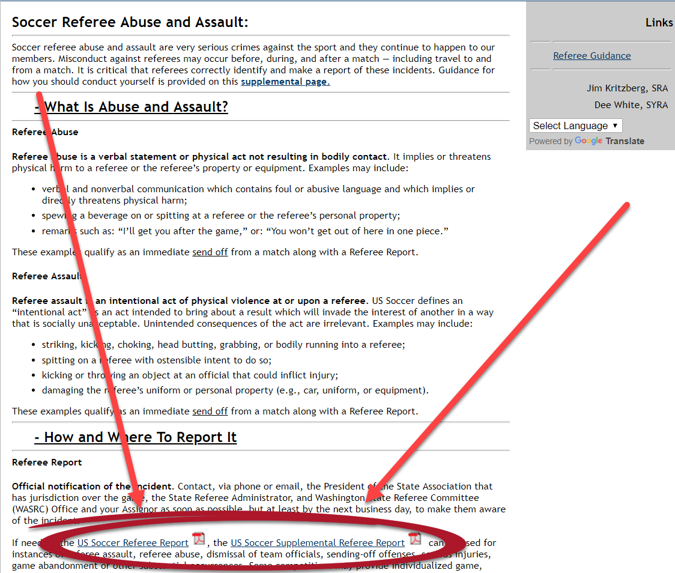
How to complete a referee report

Slide 18
How to complete a referee report
The report should be accompanied by written reports from assistant referees (if used) plus copies of any other game misconduct reports sent to the league under whose jurisdiction the match was played. If you were, or are going to be medically treated for injury, that should also be noted. For assistance in completing a report, send an email to reports@wareferees.org.

Slide 19
How to complete a referee report
File the report within 48 hours of the incident.
Retain a copy of all reports for future reference.
Multiple incidents may require the use of multiple supplemental reports to complete game report.

Slide 20
Where do I send my referee reports?
Always to:
State Referee Administrator – WASRC: Jim Kritzberg at: sra@wareferees.org
The Washington State Referee Committee Office at: waadmin@wareferees.org
Competition authorities (This can be obtained from your assignor)

Slide 21
Where do I send my referee reports?
Always to (continued):
the appropriate authority with jurisdiction for the competition
State Youth Executive Director - WYS: Roger Levesque -
RogerL@WashingtonYouthSoccer.org
or
US Club Soccer - Gabe Rood - grood@usclubsoccer.org and cc: John Borozzi (Vice President) - jborozzi@usclubsoccer.org or
State Adult President – WSASA: Timothy Busch - timbusch19@comcast.net

Slide 22
Next steps
Acknowledge all correspondence related to the report
Advise any authorized panel of your availability to attend a disciplinary hearing if requested
If requested to participate in a disciplinary hearing, either in person or by phone, an official should cooperate fully throughout the proceeding.

